Slide 1
معرفی پایگاه اطلاعاتی
PUBMED
تهیه کننده: زهرا اسدالهی
بیمارستان ضیائیان
شهریور 1398
ALLPPT.com _ Free PowerPoint Templates, Diagrams and Charts

Slide 2
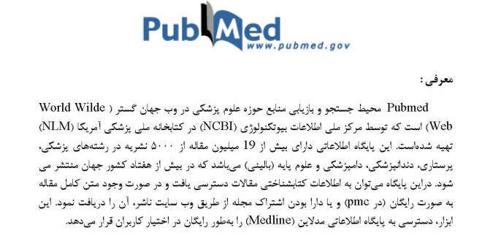

Slide 3
How do I search PubMed?
Identify the key concepts for your search.
Enter the terms (or key concepts) in the search box.
Suggestions will display as you type your search terms.
Click Search. Click here to run this search in PubMed.
Example
What role does pain have in sleep disorders?
The key concepts are: pain sleep disorders

Slide 4
How do I search by author?
Enter the author’s last name plus initials without punctuation in the search box, and then click Search. Names
entered using either the lastname+initials format (e.g., smith ja) or the full name format (john a smith) and no
search tag are searched as authors as well as collaborators if they exist in PubMed.
Example: Watson JD , Lederberg J
Click Advanced to use the search builder, and then select Author from the All Fields menu. The author search box includes an autocomplete feature.

Slide 5
Example
To search for citations to articles written by Bonnie W. Ramsey about gene therapy for cystic brosis enter the following search terms
into the search box:
cystic brosis gene therapy ramsey bw
Example
Full author names may be searched for citations published from 2002 forward if the full author name is available in the article:
Joshua Lederberg
Garcia Algar, Oscar

Slide 6
How do I search by journal name?
Enter the journal name or abbreviation in the search box.
Example
To search for articles about drosophila in the journal Molecular Biology of the Cell enter the following in the search box:
molecular biology of the cell drosophila
Click Advanced to use the search builder, and then select Journal from the All Fields menu.The journal search box includes an autocomplete feature

Slide 7
How do I find a specific citation? I have some information such as the author, journal name and the year the article was published.
Enter the information in the search box and the PubMed citation sensor will automatically analyze the search for
citation information.
Alternatively, use the Single Citation Matcher to nd citations with a ll-in-the-blank format:
1. Click Single Citation Matcher from the PubMed homepage.
2. Enter the information you have in the ll-in-the-blank boxes.
3. Click Go.

Slide 8
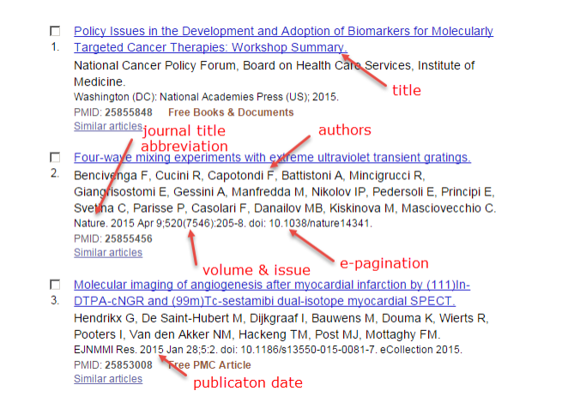
explain the serch results?

Slide 9
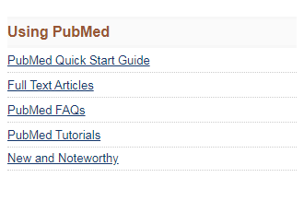
راهنما و آموزش کاربران مبتدی
توضیحاتی در مورد مقالات تمام متن
متداولترین سوالات کاربران
PubMed فایلهای آموزشی یادگیری بخش های مختلف
اطلاعیه های کوتاه برجسته در مورد پیشرفت های اخیر و تغییر
در پایگاه داده های PubMed و MeSH.

Slide 10
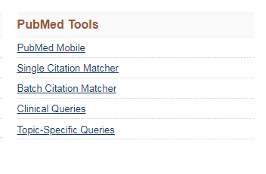
امکان جستجوی ساده منابع
امکان جستجوی یک مقاله با اطلاعات دقیق
دسترسی به PMID
شناسه منحصر به فرد هر مقاله در پاب مد
جستجوی پرسش های بالینی
و دسترسی به مقالات:
Systematic Reviews
Clinical Study Categories
Medical Genetics
راهنمایی از مقوله های موضوعی خاص موجود در پاب مد وتوصیفی از هر مقاله موضوعی

Slide 11
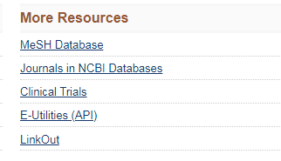

Slide 14
با تشکر از توجه شما

