Slide 1
به نام خدا
ژورنال کلاب بیمارستان ضیاییان
28 اردیبهشت ماه 1405
استاد: سرکار خانم دکترعلوی مقدم
ارائه دهنده: شایان پازوکی

Slide 2
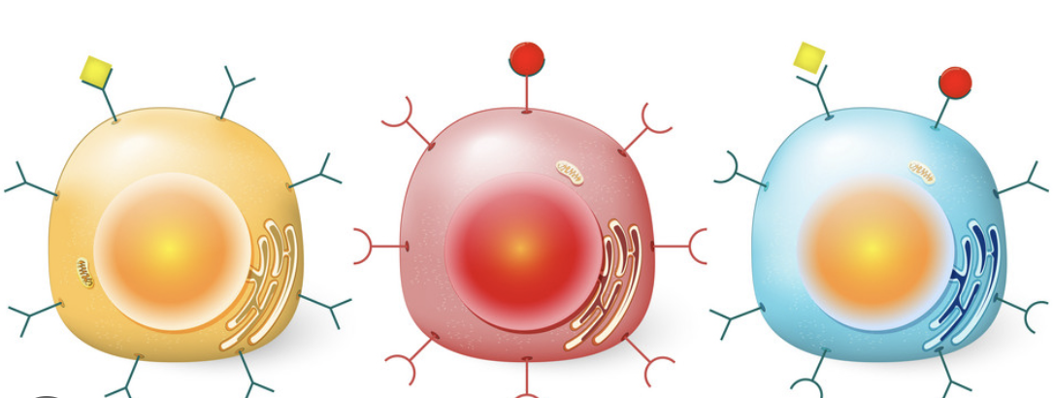
Title:
*GLP-1 receptor agonist for weight loss and fertility: Social media and online perception versus evidence-based medicine*
Published July 2,2025
Authors: *Zaher Merhi, Manasi Karekar, Marco Mouanness

Slide 3
Core idea of the paper
This paper compares:
1. Social media discussions
2. Google search trends
3. Peer-reviewed scientific literature
to examine whether people believe GLP-1 receptor agonists (GLP-1 RAs) improve female fertility, and whether that belief matches the actual evidence.

Slide 4
Glp-1
Glucagon-like peptide-1 (GLP-1) is a natural hormone that is released by the gastrointestinal system and plays an important tole in glucose homeostasis. It acts on GLP-1 receptors that are abundant in the pancreas leading to increased insulin secretion and inhibition of glucagon secretion thus lowering blood glucose levels [1]. The endogenous GLP-1 also lowers gastric emptying and increases food satiety. It slows gastric emptying, thus delaying the passage of food from the stomach into the small intestine. This prolongs the feeling of fullness after meals, leading to reduced food intake. By increasing satiety and lowering the rate at which food is digested and absorbed, GLP-1 contributes to weight loss and improved glycemic control. GLP-1 receptor agonists (GLP-1 RAs) are medications that have been used in the treatment of diabetes and its comorbidities such as cardiovascular disease and renal disease. Additionally, GLP-1 RAs have been shown in randomized trials to cause a sustained weight loss most likely by acting both centrally at the level of the brain and at the peripheral tissues.

Slide 5
Glp-1
empirical results indicate that they could impact the reproductive system including the hypothalamic-pituitary-ovarian (HPO) axis. The impact of these medications on female fertility has been studied in women with polycystic ovary syndrome (PCOS) [10] where the results have shown that GLP-1 RAs could help women with PCOS both metabolically and reproductively [11,12]. For instance, a meta-analysis study of randomized trials compared metformin to GLP-1 RAs in women with PCOS and reported that GLP-1 RAs, in addition to lowering body weight, was significantly better than metformin in improving insulin sensitivity as well as improving menstrual cyclicity, lowering serum total testosterone, lowering total cholesterol, and lowering blood pressure

Slide 6
Why this paper matters
GLP-1 receptor agonists such as semaglutide and related drugs are widely discussed because they are used for:
1- weight loss
2- metabolic improvement
3- possible effects on fertility
Social media hashtags such as #ozempicbabies and #ozempicpregnancy may create the impression that these drugs improve fertility broadly.
The paper tests whether that perception is supported by evidence.

Slide 7





Study design and methods
Group 1: social media
platform analyzed: 1-reddit 2-twitter 3-tiktok
** Reddit sentiment analyzed with VADER through Communalytic/ Twitter and TikTok posts were manually searched and scored using an internal objective scale/ Posts were classified as:- Positive- Neutral- Negative**
Group 2: online search behavior
Google trends was used
Group 3: medical literature
PubMed search was conducted
** The focus was on fertility-related outcomes and infertility-associated conditions**

Slide 8

Main findings
a. Social media and Google Trends were mostly positive
Across Reddit, Twitter, TikTok, and Google Trends:
- Positive sentiment was highest
- Neutral came second
- Negative was lowest
This means the online conversation generally suggests a favorable link between GLP-1 RAs and fertility.

Slide 9
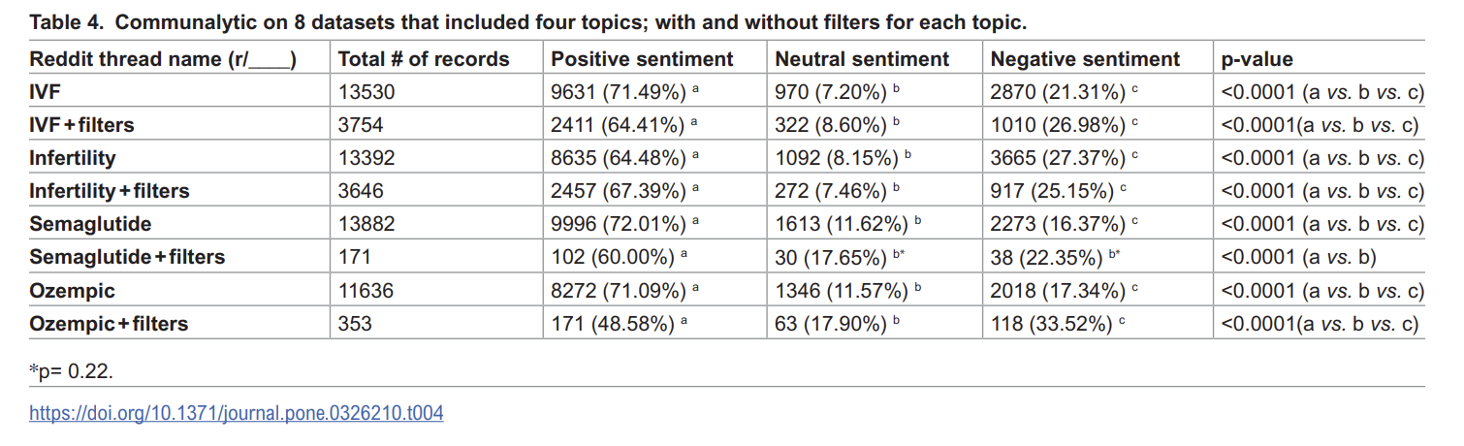
on Reddit social platform, out of 46,972 total number of records analyzed including all post headers, comments, replies and excluding reposts and duplicates, there was a significantly higher Positive sentiment compared to Neutral sentiment (4,720±1,669 vs. 659±243; respectively, p=0.027; Table 3). There was trend towards higher score for Positive sentiment compared to Negative sentiment (p=0.068). Negative and Neutral sentiments has similar scores (p=0.88).

Slide 10
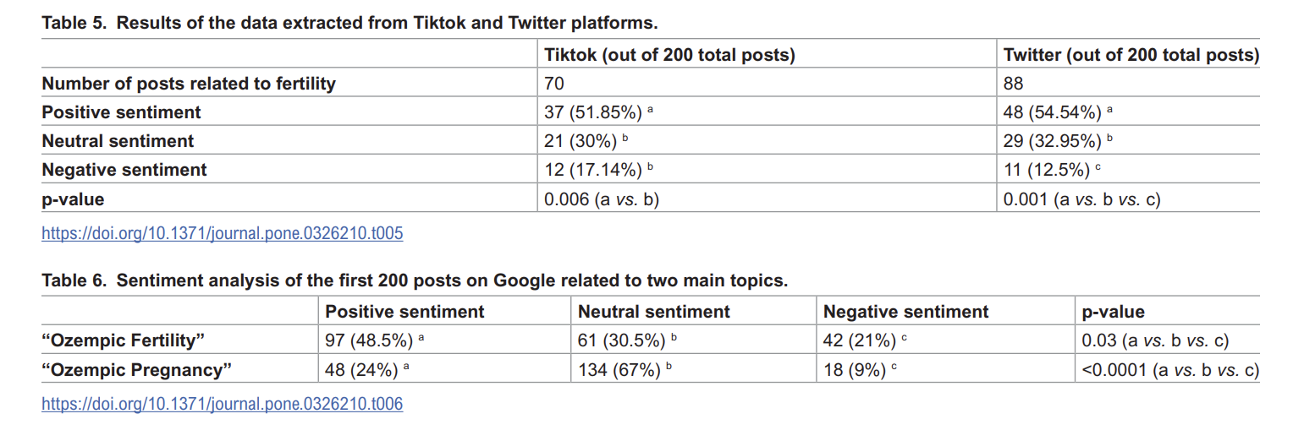

Slide 11

Main findings
B. Scientific literature was positive mainly in PCOS
Among PubMed studies, the strongest evidence was in women with PCOS.
The paper reports that:
- 52 original PubMed studies in women with PCOS were all classified as positive
- But for women without PCOS, there were no human studies supporting fertility benefit

Slide 12
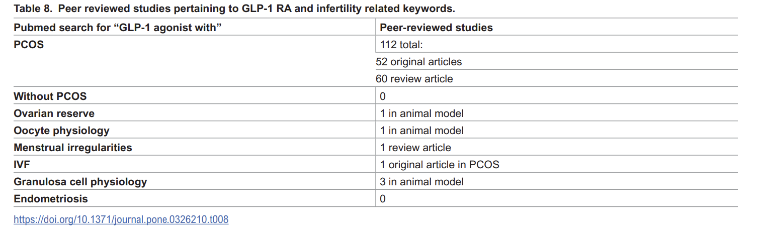
There were no studies in humans (including case reports, case series, cohort, case-control, or trials) evaluating the impact of GLP-1 RAs on ovulation, implantation, IVF, or any fertility status in women without PCOS, but there were a few studies in animals that showed controversial results with negative impact on fertility

Slide 13
Main findings
c. Strong correlation across domains
The authors found a strong positive correlation between:
- social media sentiment
- Google Trends sentiment
- scientific literature sentiment

Slide 14
discussion
Studies using social media data face several limitations. Self-reported information can be inaccurate or incomplete, and the users providing these reports may not reflect the general population’s social, economic, or demographic diversity. The presence of fake accounts may also impact data quality. These limitations highlight the need for cautious interpretation and support the integration of other research methods. Additional concerns include researcher bias, language variability, and users’ self-presentation, which may influence data reliability. The exclusive use of English and specific keywords could introduce selection bias and exclude relevant content. Differences in user demographics across platforms further limit generalizability. Additionally, this study did not compare specific GLP-1 RAs that are used at different frequency (for example: tirzepatide versus semaglutide) or administration methods of these drugs.

Slide 15
discussion
For example, sarcasm, slang, or context-dependent expressions may be misclassified by automated tools, leading to potential distortions in sentiment interpretation. Furthermore, certain health-related keywords (e.g., “pain,” “weight,” or “injection”) might inherently carry a negative tone, even in neutral or informative contexts. Such factors could influence the overall sentiment trends observed in the data, and may over- or under-estimate public perception. Different platforms (e.g., Twitter, Instagram, Reddit) have varying norms for language, tone, and engagement. What’s considered “neutral” on Reddit might be “negative” on Instagram. Finally, reducing sentiment to only three categories (positive, negative, neutral) may overlook mixed sentiments, sarcasm, or nuanced discussions that include both support and concern. Therefore, while sentiment scores provide a valuable quantitative overview, findings should be interpreted with caution and ideally validated through manual review or triangulated with qualitative methods.

Slide 16

Do GLP-1 RAs improve reproduction in women with PCOS?
GLP-1 receptors are found in the hypothalamus, pituitary, and reproductive organs like ovaries and uterus, logically suggesting an impact on female reproduction.
PCOS and Treatment: Healthy lifestyle and weight loss care in obese women with PCOS can improve metabolic and reproductive disturbances, potentially restoring ovulation and fertility. Metformin is a gold-standard therapy for PCOS with glucose intolerance.
GLP-1 RA Efficacy in PCOS: GLP-1 RAs have been relatively well-studied in obese women with PCOS, showing reassuring data on weight loss, visceral fat, insulin resistance, menstrual regularity, gut microbiota, fatty liver disease, and cardiometabolic parameters.
Comparison with Metformin: A meta-analysis of randomized trials indicated that GLP-1 RAs significantly improved insulin resistance, blood pressure, cholesterol, and menstrual irregularities, while also lowering weight/abdominal circumference and androgen indices/hirsutism, outperforming metformin alone.
Fertility and IVF Outcomes: In a study on obese PCOS women undergoing IVF the intake of metformin with liraglutide (a GLP-1 RA) for 3 months resulted in a significantly higher pregnancy rate after IVF (85.7%) compared to metformin alone (28.6%), even though weight loss was similar. This suggests GLP-1 RAs may have direct, favorable effects on the reproductive system.
Cellular Effects: Studies on granulosa cells from a PCOS mouse model showed that GLP-1 RAs have a favorable effect on granulosa cell proliferation (and reduced apoptosis) via the forkhead box protein O1 (FoxO1).
indirectly via weight loss and directly by acting on the ovaries

Slide 17
Any justification for the use of GLP-1 RAs in women without PCOS?
at the time of writing, there were no human studies on whether GLP-1 receptor agonists (GLP-1 RAs) affect fertility in women without PCOS. However, several animal studies suggested possible negative effects on reproduction.
Main points: Liraglutide in rats was linked to→higher androgen levels, lower LH, FSH, estradiol, and progesterone, reduced ovarian weight, poorer ovarian antioxidant defense, damage to granulosa cells and follicles, and uterine tissue damage with more apoptosis. Natural GLP-1 reduced FSH-induced progesterone production and cAMP signaling in rat granulosa cells, while lowering key steroidogenic enzymes. Exendin-4 (Ex4) appeared to disrupt the hypothalamic-pituitary-ovarian axis by lowering LH, suppressing the LH surge, reducing Kiss-1/Kiss-1r expression, and delaying puberty.

Slide 18
conclusion
Women with PCOS are a unique population that is very distinct than than those without PCOS because they could have metabolic dysfunction that understandably would benefit from the anti-diabetic actions of the GLP-1 RAs. The vulnerability of this infertility population and the wealth of online and social media misinformation (such as “#ozempicbabies” and “#ozempicpregnancy”) is causing a dramatic rise in the use of the quick fix GLP-1 RA medications with their unknown reproductive consequences [36]. There is a clear need for long-term studies in women without PCOS, to assess the impact of GLP-1 RA medications in a dose-response manner on reproduction to evaluate their safety since many women of reproductive age are resorting to these medications without knowing whether they could have any negative impact on their future fertility.

Slide 19
با تشکر...

