Slide 1
Approach to Lower GIB
استاد راهنما دکترمنصوری (متخصص داخلی)
ارایه دهنده مرجان آسودگی (دستیار پزشکی خانواده)

Slide 2
Case: History
شکایت: بیمار آقای 46 ساله، ارجاع به اورژانس از درمانگاه پزشکی خانواده به علت ضعف و بی حالی، دفع خون روشن از مقعد و آنمی
بیماری فعلی: بیمار آقای 46 ساله بدون بیماری زمینه ای با شکایت:
  دفع خون روشن از رکتوم (BRBPR) از یک سال قبل به صورت intermittent که از یک ماه قبل تشدید شده
  با هر نوبت اجابت مزاج خونریزی با حجم متوسط داشته (پر شدن کاسه توالت از خون)

Slide 3
Case: History
علایم همراه :
  گوارشی: یبوست + ولی ملنا، هماتمز، درد شکم، حالت تهوع یا استفراغ، اسهال و... را ذکر نمیکرد
  سیستمیک:
    ضعف و بی حالی از چندین ماه قبل
    تنگی نفس فعالیتی بدون درد قفسه سینه، سرفه ...
    تب و لرز و کاهش وزن و ... را ذکر نمی کرد
PMH: شرح حال مشکوک از پرکاری تیرویید، همورویید، سابقه کم خونی بررسی نشده سال قبل (Hb=8.2
DH: منفی
SH: کارگر ساده با تحصیلات راهنمایی، ساکن منطقه روستایی مرتضی گرد، سابقه مصرف تریاک را ذکر می کرد.

Slide 4
Case: Physical Exam
HEENT: ملتحمه pale
Chest: سمع قلب S1, S2 نرمال، بدون سوفل، سمع ریه clear
Abdomen: شکم نرم بدون گاردینگ و تندرنس و ریباند/ بدون آسیت وارگانومگالی
Extremities: نرمال
GA: بیمار هوشیار، در ظاهر رنگ پریده است، دیافورتیک نیست و دیسترس تنفسی ندارد
  PR: 95
  BP: 98/60
  SpO2: 98%
  T: 36.8

Slide 5
Case in Summary
46 year-old male with CC:
  1year of intermittent BRBPR worse x 1 month
  With every defecation
  Moderate volume
A/S
  Constipation (+)
  No melena, No hematemesis, No abdominal pain, No nausea/vomiting
  Generalized fatigue and weakness x several months
  Exertional Dyspnea x few months
  No dizziness or lightheadedness
PMH: Hemorrhoid, Hyperthyroidism (?), anemia
DH: Neg
SH: Opiate addict
Ph/Ex:
  PR:95/ BP:89/60
  Pale skin and conjunctiva
  Chest: S1, S2 NL, No murmur/ Lungs clear
  Abdomen: No tenderness, guarding, rebound or organomegaly

Slide 6
Case: Initial Labs
Hb= 3.9
HCT= 16.4
MCV= 82
MCH=19.5
WBC=4.9
Plt= 269
PBS= Anisocytosis, Hypochromia, Slight macrocytosis
Ferritin=8.1
SI=15
TIBC=316
B12=902/ Folate=19
Urea= 15/ Cr=1.1/Na=136/K=3.7
INR=1/ PTT=25
TSH=2.7/ T4=10.3/T3=2.1

Slide 7
سوال؟
نکاتی کلیدی که در شرح حال، معاینات و آزمایشات بیمار در تصمیم گیری اولیه به شما کمک میکند؟

Slide 8
Lower GIB: Assessment
Characteristics of bleeding:
  Color
  Mixed/streaks/ clot
  Frequency/ Amount/ Speed
Hx of Previous GIB
A/S:
  GI: Melena, Hematemesis, Diarrhea, Abdominal Pain, Bowel movements
  Unexplained weight loss
  Signs of hypovolemia: Syncope or pre-syncope
PMH:
  Hx H. Pylori / GIB/ PUD/ IBD/ Surgeries/ Radiation
  Comorbidities: CAD! – increased mortality
DH:
  NSAIDs
  Anti platelet/Anti coagulant
  Beta blockers! – Mask Tachycardia
SH: Alcohol
Ph/Ex: Hemodynamic stability
  Vital signs (Orthostatic Vitals?)
  Abdominal pain

Slide 9
Lower GIB: High risk features:
Hemodynamic instability (hypotension, tachycardia, orthostasis, syncope)
Persistent bleeding
Significant comorbid illnesses
Advanced age
Current use of Aspirin
A non tender abdomen
No diarrhea
Prolonged PT
Anemia – Hb<7 → But higher threshold in some patients
Elevated BUN*
Abnormal WBC
Hypoalbuminemia

Slide 10
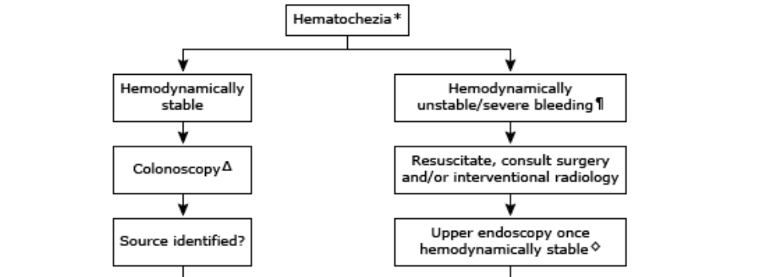

Slide 11
Case: Resuscitation
Cardiac monitoring and pulse oximetry
Supplement oxygen by nasal cannula
NPO if urgent upper endoscopy is needed
IV Fluid resuscitation with isotonic serums (as bridging to blood transfusion)
Type and cross-match
Blood transfusion (Main Tx) – after 2 units of pack cell (Hb:3.9 → 6.2)
Surgical consult
GI consult

Slide 12
Clinical manifestations
Hematochezia
  Dark/maroon blood
  Bright Red Blood
  Clots

Slide 13
Causes
Diverticulosis
Hemorrhoids
Neoplasms/ Polyps
Angiodysplasia
IBD
Radiation induced
Ischemic colitis

Slide 14
Approach to Lower GIB

Slide 15
Hemodynamically Stable
Minimal BRBPR (few drops, on toilet paper, on the surface of stool)
  If age<40, No RF, No persistent bleeding, No red flag AND a potential source of bleeding
  Others need further investigations
Stable Lower GIB
  Colonoscopy – first step
  Upper endoscopy if IDA, non self-limiting, multiple episodes

Slide 16
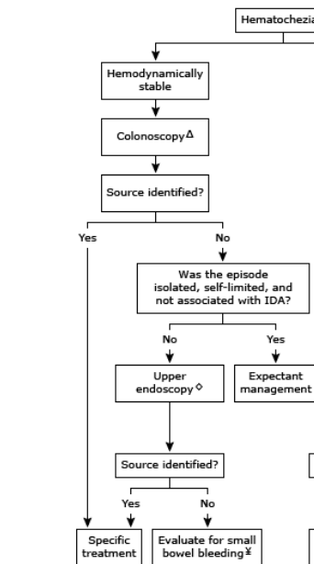

Slide 17
Presence of hemorrhoids does not exclude a more proximal culprit lesion and could even mask the concomitant bleeding of an early neoplastic lesion.
Visualization of a potential bleeding site that is not actively bleeding does not exclude the presence of a more proximal source. The identification of more than one potential bleeding site is common (eg, diverticulosis and hemorrhoids).
Even if a lower gastrointestinal tract source is considered possible, these patients are more likely to have proximal rather than distal colonic lesions and should undergo colonoscopy after upper gastrointestinal tract investigations

Slide 18
Unstable/Severe bleeding
Initial resuscitation & stabilization
Surgical consult
Upper endoscopy
Colonoscopy
CT angiography

Slide 20
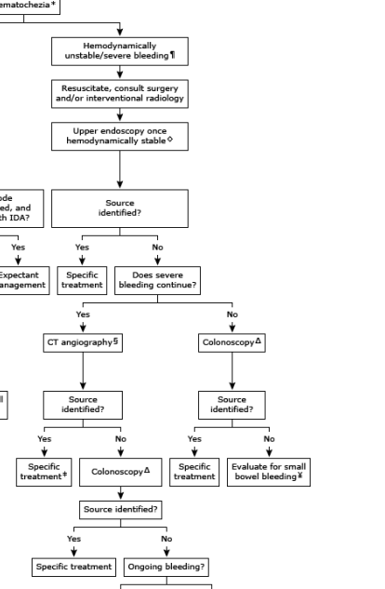

Slide 21
Case: Assessment & Managment
Endoscopy
  Gastropathy (Multiple linear erythematous mucosal at antrum)
  Biopsy – Mild chronic inactive gastritis, Negative for intestinal metaplasia, dysplasia, Neg H Pylori
Colonoscopy
  Internal hemorrhoid
  Normal mucosa and vascular pattern of colon
  Biopsy – Negative for neoplasm

Slide 22
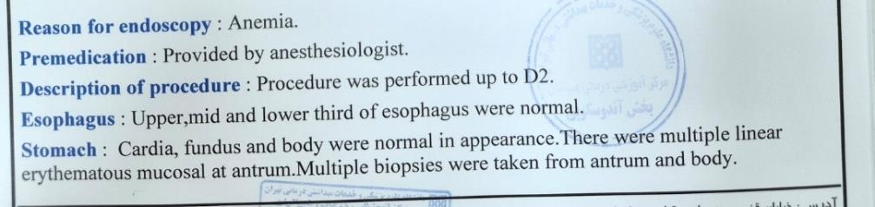
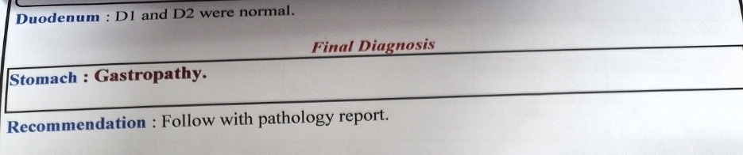
Case: Endoscopy

Slide 23
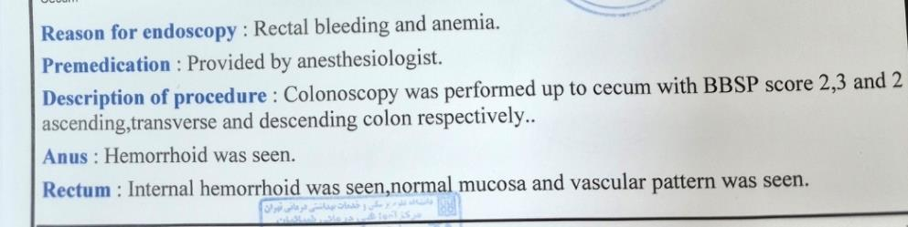
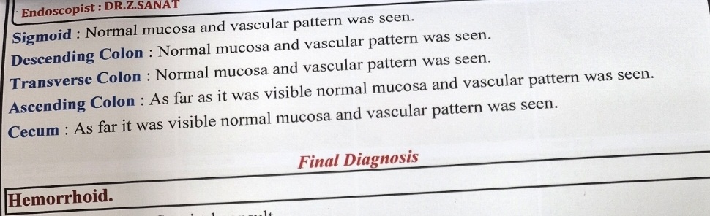
Case: Colonoscopy

Slide 24
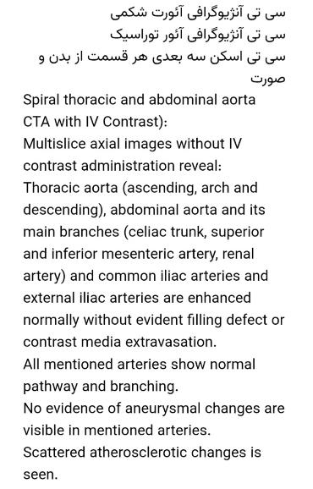
Case: CT angiography

Slide 25
Case: Assessment & management
CT Angiography
  “Thoracic, abdominal and its main branches … are enhanced normally without evident filling defect or contrast extravasation”
Abdominal and pelvic ultrasound – Mild splenomegaly (~134mm)/ otherwise NL
Hemorrhoid surgery – Hemorrhoidectomy
Hematology consult – if anemia is not explained by the amount of hemorrhoid bleeding → small bowel assessment
Capsule endoscopy (referred to Emam-Khomeini Hospital)

Slide 26
Primordial Prevention
Promote healthy diet
Encourage physical activity
Public health policies to:
  Reduce unnecessary NSAIDs availability
  Limit alcohol and opioid access
Population-level education on:
  Risk of smoking (IBD, Colon cancer)
  Rational medication use (OTC NSAIDs aspirin)
  Cancer screening awareness

Slide 27
Primary Prevention
Avoid or minimized NSAIDs use
Avoid opioids use
Appropriate use of aspirin and anticoagulants
Treat constipation early – less hemorrhoids, fissures
Control IBD activity
Manage radiation exposure carefully in pelvic malignancies

Slide 28
Secondary Prevention
Colorectal cancer screening – FIT/colonoscopy
Early evaluation of IDA or occult blood in stool
Surveillance colonoscopy in long-standing IBD or previous polyps
Early diagnosis and treatment of angiodysplasia, polyps, …

Slide 29
Tertiary Prevention
Acute management
  Hemodynamic stabilization
  Blood transfusion if needed
Definitive treatment
  Endoscopic therapy
  Surgery or embolization
Secondary prophylaxis
  Stop or adjust anticoagulants/antiplatelets
Prevent recurrence

Slide 30
Quaternary Prevention
Avoid:
  Unnecessary repeat colonoscopy
  Over transfusion
Deprescribing
Focus on:
  Symptom control
  Quality of life
  Palliative care when appropriate

