Slide 1
Efficacy and safety of statins in masld & other chronic liver diseases
Journal presentation
Authors: I. Commins, D.Clayton-Chubb, W. Kemp, A.Majeed, S.K. Roberts
Source: medical sciences 2026
Presenter: Sara Ghasemzadeh

Slide 2
Background & aim
1. Evidence for statin use in MASLD patients for lipid lowering
2. Potential direct therapeutic effects of statins in MASLD and its complications
Why is this important?
- MASLD affects 38% of adults worldwide
- It is strongly linked to CVD and premature mortality
- Despite proven CVD benefits, statins are underprescribed in MASLD patients

Slide 3
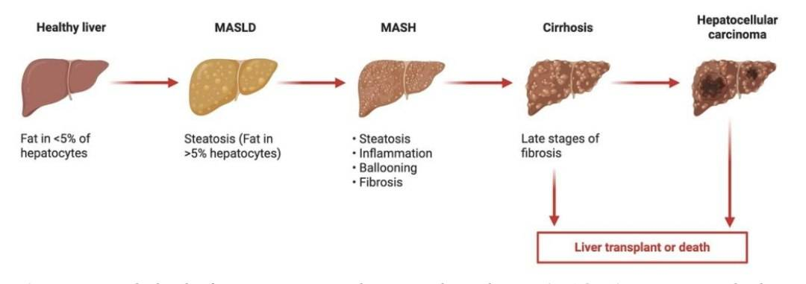

Slide 4
Statins mechanism of action
Inhibition of HMG-CoA reductase enzyme
Upregulation of hepatic LDL receptors & reduce LDL-C levels by 22-55%
Pleiotropic effects:
Improve endothelial functions
Stabilisation of atherosclerotic plaques
Anti-inflammatory & Anti-thrombotic effects
Immunomodulatory

Slide 5
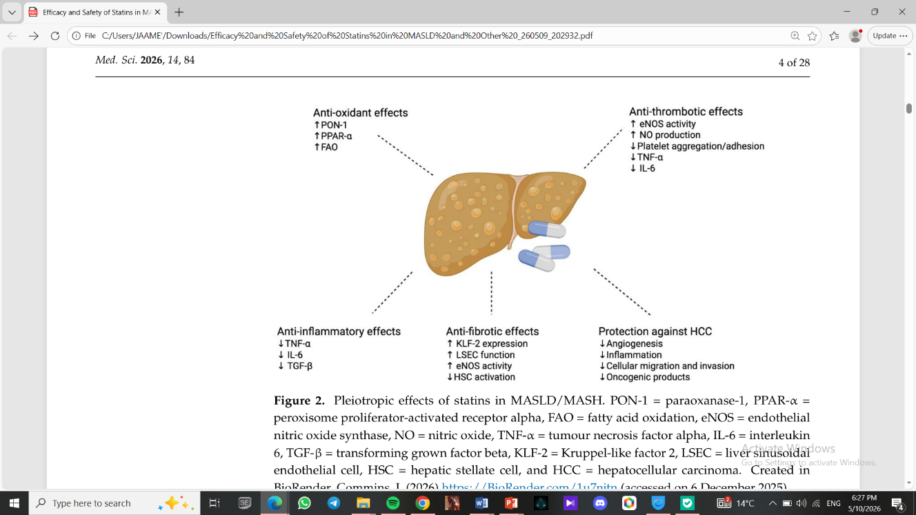

Slide 6
Statins & masld
Studies suggest statins lower MASLD risk.
One RCT: Atorvastatin (20mg) + Vit C & E for 4 yrs reduced steatosis by 71% (statin’s sole effect unclear).
Higher doses & longer duration may increase effectiveness.
A Cochrane meta-analysis: statins improve both serum aminotransferase levels and sonographic hepatic steatosis

Slide 7
Statin effect on mash & fibrosis
Statins are inversely associated with MASH.
One RCT: Rosuvastatin + NAC reduced steatosis by 19.5% (p= 0.017) and fibrosis by 19.5% (p = 0.001).
protective, dose-dependent association between statins and liver fibrosis.
Proposed mechanism: inhibition of paracrine signaling between hepatocytes and hepatic stellate cells (HSCs).
This may lead to HSC inactivation and reduced fibrosis.

Slide 8
Cardiovascular benefits
Reduce ASCVD mortality/morbidity by 50% in MASLD/MASH patients.
Two-thirds reduction in cardiovascular events for statin users vs. non-users.
Guideline Recommendations:
Use statins for dyslipidemia in MASLD.
Pre-liver transplant cardiac optimization with statins for MASLD patients.

Slide 9
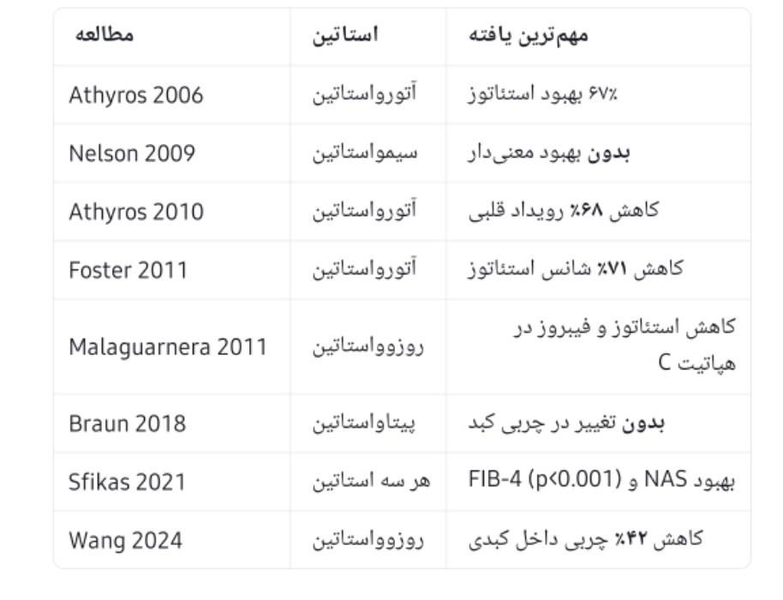

Slide 10
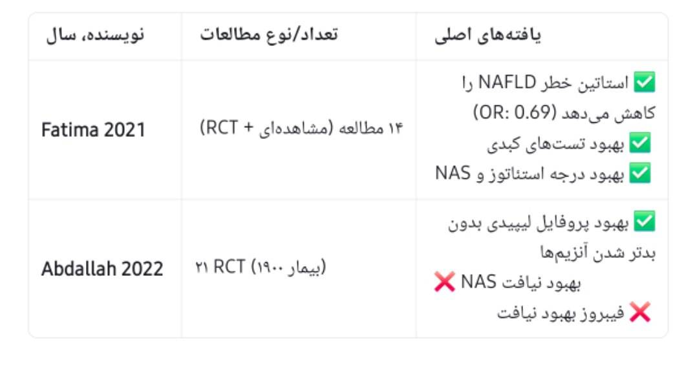

Slide 11
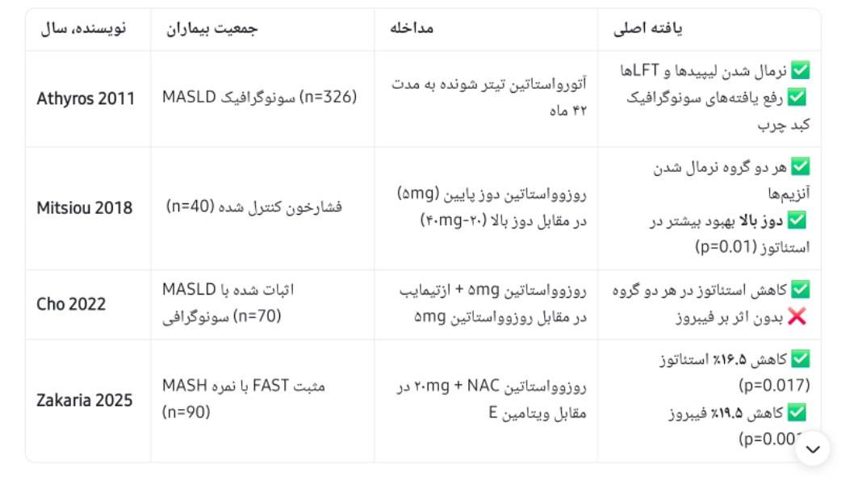

Slide 12
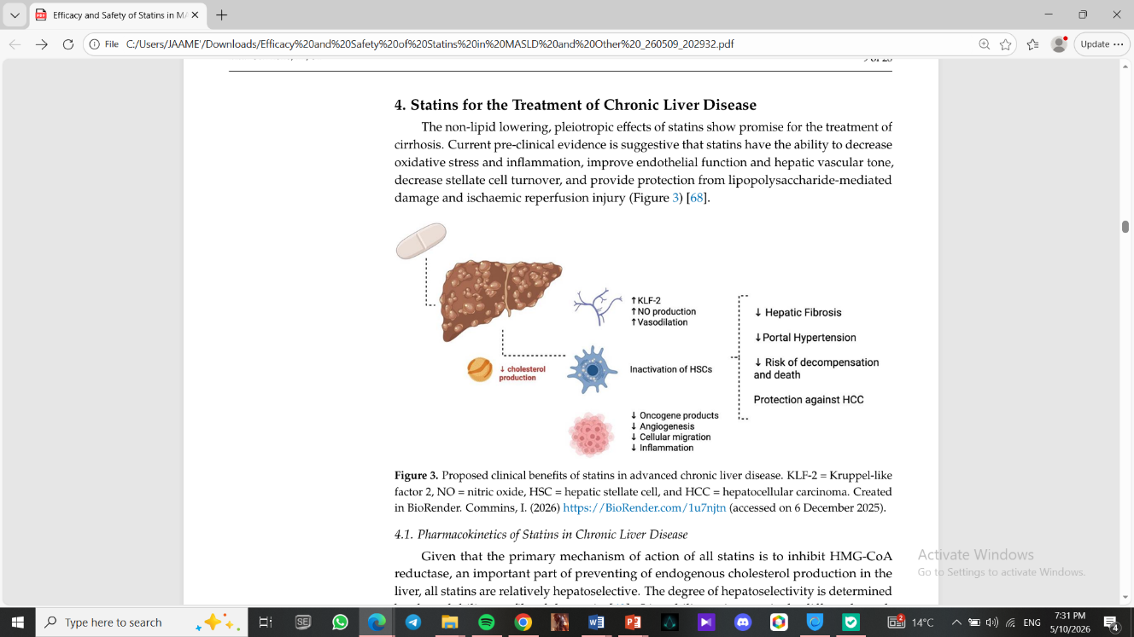
Statins for the Treatment of Chronic Liver Disease

Slide 13
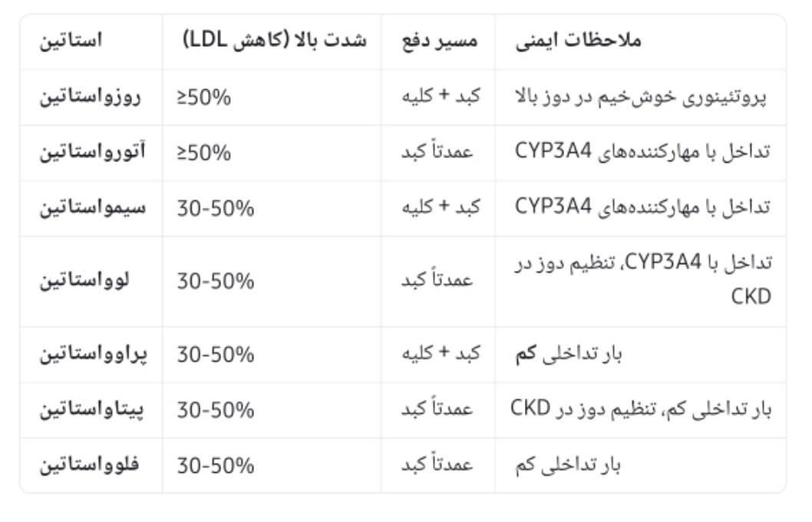

Slide 14
decompencation
Lower risk of decompensation and death
Lower risk of hospitalisation for infection
Lower risk of acute on chronic liver failure

Slide 15
Statins in Cirrhosis & Portal HTN
Beneficial Mechanisms of Statins in Cirrhosis
Reduces oxidative stress & inflammation
Improves endothelial function & hepatic vascular tone
Decreases stellate cell turnover
Activates KLF-2-NO pathway → Lowers hepatic vascular resistance
Simvastatin: Significantly reduced HVPG by 8.3%
Statins + Carvedilol: Greater HVPG reduction than carvedilol alone

Slide 16
Statins and HCC Risk
More than 20 retrospective studies have demonstrated an association between statin use and a reduced incidence of HCC.
In diabetic patients with MASLD cirrhosis: 25% reduction in HCC risk.
In patients undergoing HCC resection or transplantation: Lower recurrence rates in statin users (though no survival benefit).

Slide 17
Statins & safety

Slide 18
Adverse Effects
1. Statin-associated muscle symptoms (SAMS):
The most common adverse effect (>70% of side effects).
Higher risk: Lipophilic statins (simvastatin, atorvastatin), high doses, advanced age, and frailty.
2. New-onset diabetes mellitus (NODM):
Increased relative risk of 9-12% (particularly with high doses and more potent statins).
However, cardiovascular benefits far outweigh the diabetes risk.
3. Hepatotoxicity:
Elevated transaminases are usually mild and transient.
Drug-Induced Liver Injury (DILI) is rare (<1%).
Caution is advised in decompensated cirrhosis (Child-Pugh >9), particularly with high-dose simvastatin

Slide 19
Statins between the sexes
Women report higher rates of SAMS's compared to men
Higher reports of NODM associated with statin in women
Women tend to discontinue statin therapy more frequently than men

Slide 20
Statins in older adults
Over 80% of people die from cardiovascular disease are >65 years old
There are no strong prescribing guidelines for older adults without ASCVD
recent cohort study: there were 7779 reported cases of DILI from 167112 cases

Slide 21
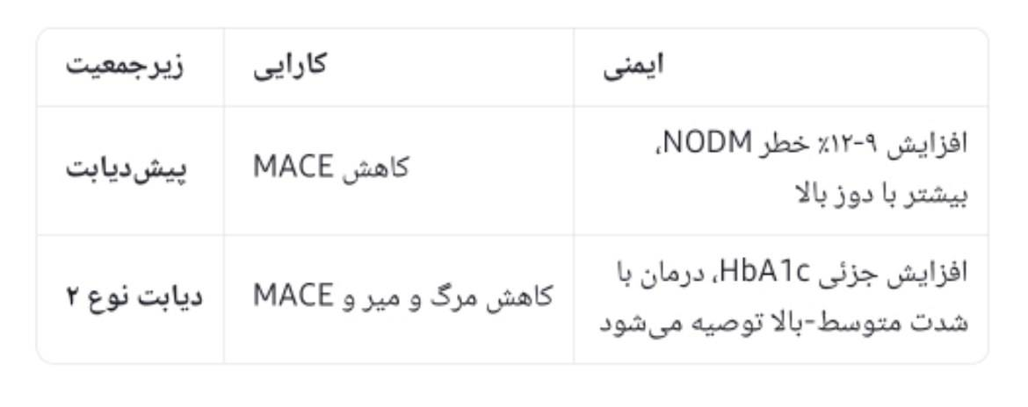
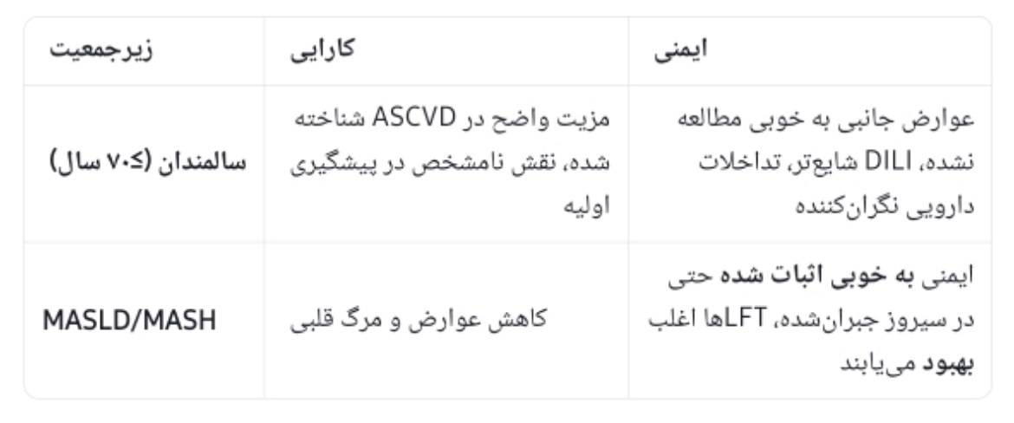

Slide 22
conclusions
Statins should be considered much more broadly in patients with MASLD.
Key Reasons:
1. Significant reduction in mortality and cardiovascular events (halving ASCVD mortality).
2. Growing evidence for the improvement of steatosis and fibrosis.
3. Benefits in cirrhosis (reduction of HVPG) and decreased HCC risk.
4. Proven safety even in compensated cirrhosis.

Slide 23
Unanswered Questions
1. Are statins beneficial in MASLD patients without hyperlipidemia (primary prevention)?
2. What is the optimal dose and duration of statin therapy for fibrosis and MASH?
3. Need for large RCTs with histological endpoints (liver biopsy).
4. Are statins safe in decompensated cirrhosis (Child-Pugh C)? (Limited data).
5. What is the risk of NODM in the MASLD population who already have insulin resistance?

Slide 24
Strengths & Limitations
Strengths:
Most comprehensive recent review (2026).
Covers all aspects from MASLD to HCC.
Cites numerous RCTs and meta-analyses.
Very practical summary tables.
Limitations (stated by the authors):
Most studies on fibrosis and MASH are observational.
Few large RCTs with histological endpoints.
Limited data in decompensated cirrhosis.
Generalizability of results from viral populations to MASLD remains uncertain.

Slide 25
Thanks for your attention

